Slide 1
Recitation
Administrivia
CS 0441 Discrete Structures for Computer Science
(Fall 2022)
Shinwoo Kim
shinwookim@pitt.edu
sites.pitt.edu/~shk148/teaching

Slide 2
Are you in the right place?
This is Recitation for CS 0441 · Discrete Structures for Computer Science.
Lecture Section 1090
with Prof. Donald Bonidie
which meets in 5502 Sennott Square
on Mondays & Wednesdays at 4:30PM - 5:45PM
Recitation CRN: 17064 (Fridays 4:00PM - 4:50PM)
501 Information Sciences Building
Please make sure you’re in the right place.

Slide 3
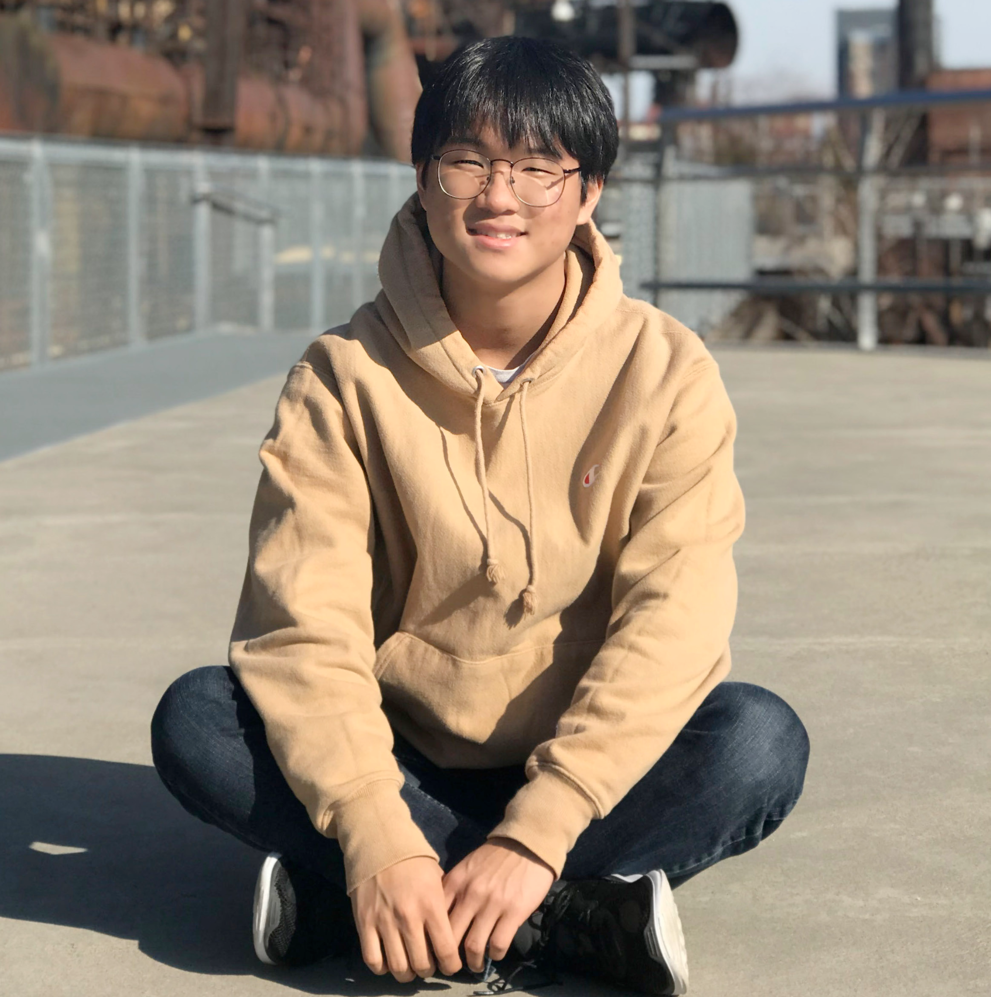
Hello!
I’m Shinwoo. I’m your TA for this term.
shinwookim@pitt.edu
sites.pitt.edu/~shk148/teaching/
Office hours: See Canvas
Religious absences: contact me ASAP
Students with disabilities: contact DRS ASAP
Covid Policies: see Univ. website
↑ All this on Canvas.
Shinwoo Kim (He/Him/His)

Slide 4
Communication
I send announcements through Canvas which come thru email
it is not my responsibility to make sure you get them, it’s yours
For "official" communications, or if you need my attention immediately, use email.
Append [CS 0441] to Subject; Include your name & section in body.
Give me at least 24 hours to respond
My business hours are weekdays 9AM - 5PM
If I don’t respond after 24 hours, send me another message!!!

Slide 5
Welcome to CS441!

Slide 6

Textbook
Kenneth H. Rosen. Discrete Mathematics and Its Applications, 8th Edition, McGraw Hill
You should be able to access it via Canvas
‘RedShelf Inclusive Access’ tab on Canvas
If you want to get a paper copy/use your own copy, you need to ‘opt-out’ before the deadline to get a refund
YOU MUST HAVE A TEXTBOOK TO DO HOMEWORK (worth 30% of your grade)
CONTACT ME ASAP IF YOU CAN’T ACCESS YOUR TEXTBOOK

Slide 7
What is recitation?
Recitation = “Applying what you’ve learned in lecture towards solving specific concrete problems”
and compare your solutions to those problems with those of your TA

Slide 8
Recitation Structure
During most recitations:
I’ll take questions from you
questions can be about lecture topics, homework questions, or anything class-related
It’s your responsibility to identify problems that are difficult and bring them to recitation
I’ll work out those problems and any other similar problems
And sometimes, I might ask one of you to come up and work through them in front of the class
If we get through 1 & 2, we’ll work on the problems that I’ve prepared
*with similar formats as those on the exams
You are expected to participate—not just listen. Ask Questions!!!

Slide 9
I’m here to help, but don’t
Wait until the last minute to ask questions. There are only so many hours in a day.
If you wait until the last minute, I can’t guarantee a response until after the due date.
E-mail me for a solution to a homework problem
Email is not great for giving step-by-step help
I will usually reply with ‘Please bring the question to REC/OH’
You must show proof that you’ve attempted the problem.
Distributing answers via E-mail can be an ACADEMIC INTEGRITY VIOLATION

Slide 10
Speaking of Academic Integrity
Don’t Cheat
It’s really easy to tell if you cheat.
You’re here to learn (by your own will); You won’t learn if you cheat.
You will fail! Getting a C or D is better than getting an F
Also, scary university people get super mad!

Slide 11
Classroom behavior & expectations
If I or someone else is making you feel unwelcome or uncomfortable, please contact me privately
Be respectful in class (to me and your peers). You’re an adult.
Adults accept responsibility and apologize; they don't say "it was just a joke/meme" or "you're too sensitive"
DON’T STRUGGLE IN SILENCE!!!! EVER!!
Ask questions in recitation
Come to office hours
Peer tutoring[Navigate]
Notes:
Slide materials from Jarrett Billingsley

Slide 12
Questions?
Notes:
If you have personal questions, see me after.

